Slide 1


Code Refactoring and Bugs fixing Task
Preethi Sundar-IN1241091
(INNOMATICS RESEARCH LABS)

Slide 2
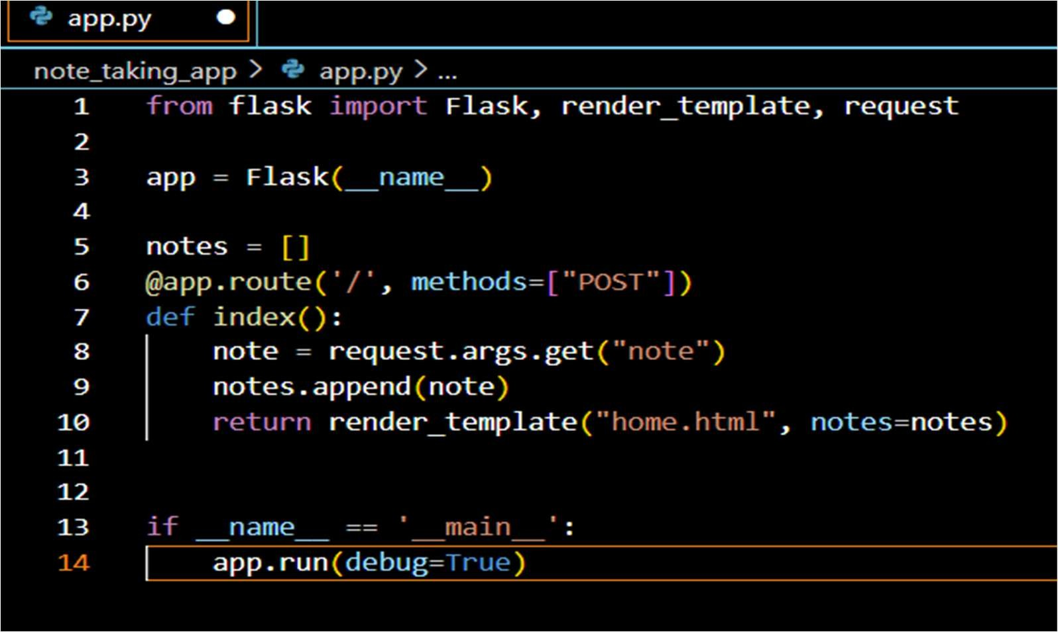
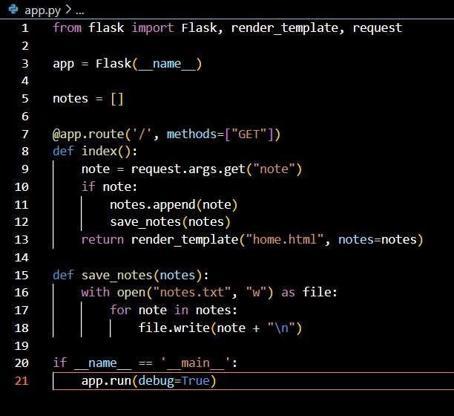
Code Refactoring and Bug Fixing
Code Refactoring
Code refactoring is the process of restructuring existing code without changing its external behavior. It aims to improve code readability, maintainability, and sometimes performance.
Bug Fixing
Bug fixing involves identifying and resolving issues or errors (bugs) in software that cause it to behave unexpectedly or incorrectly.
Existing code
After refactoring and fixing bugs on the existing code and I initiated code for save notes

Slide 3
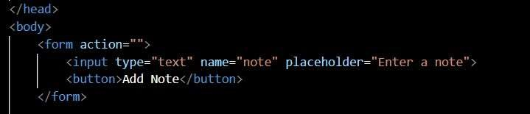
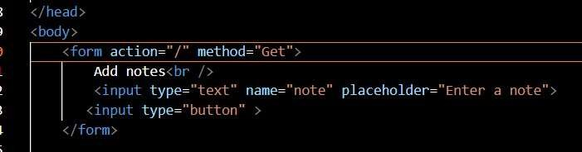
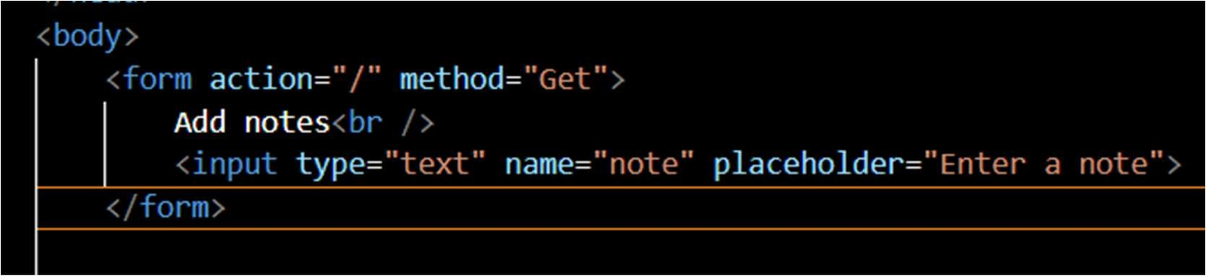
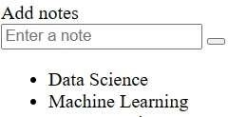
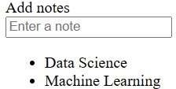
Html code with bugs
Final html code after bugs fixed
Difference between the execution with<button> and without <button>

Slide 4
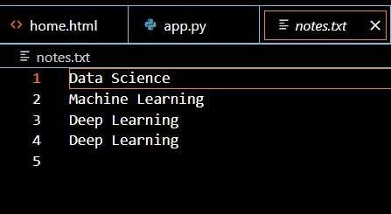

Notes.txt helps to save notes while taking notes for future reference
Conclusion:
After refactoring and fixing bugs in the provided code, the application is now capable of efficiently managing notes. Users can input their notes through the interface, and the application ensures that these notes are properly saved for future reference. With these improvements, the application offers a more streamlined and reliable experience for note- taking.

